Slide 1
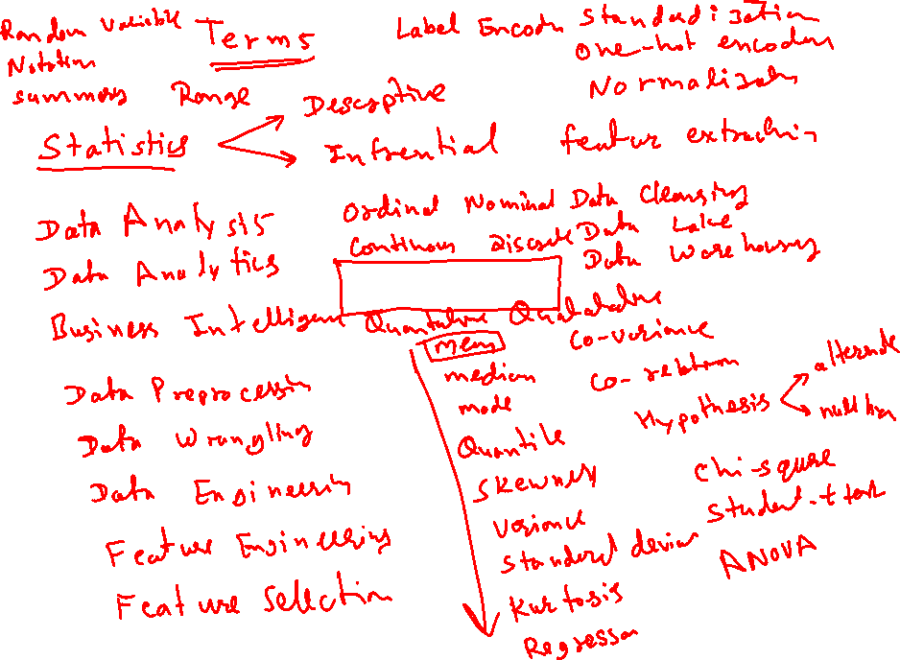
Statistics

Slide 2
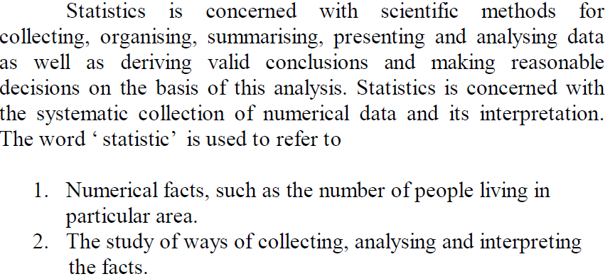
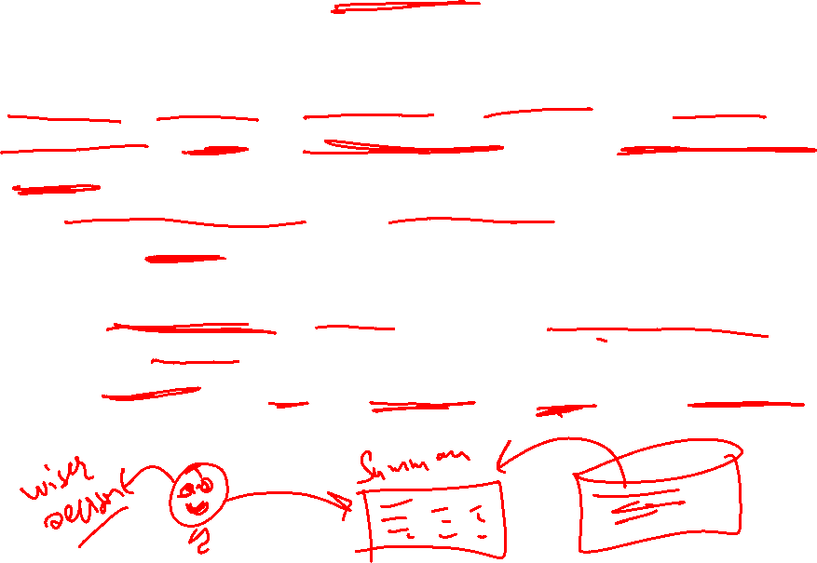
Statistics

Slide 3
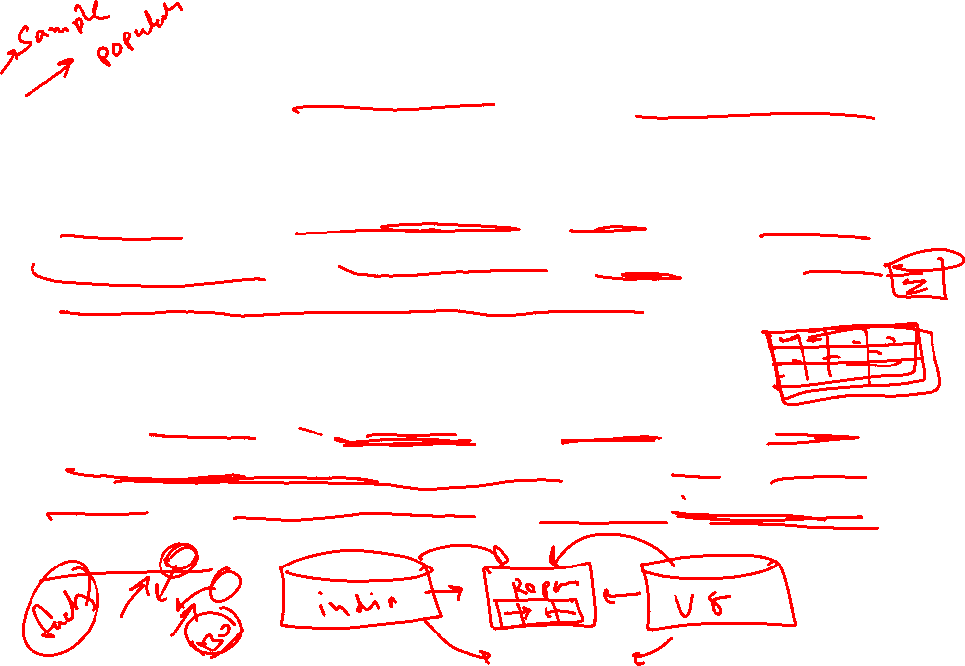
Statistics
“Statistics is the mathematical science involving the collection, analysis and interpretation of data”
“Statistics are the classified facts representing the conditions of people in a state. In particular they are the facts, which can be stated in numbers or in tables of numbers or in any tabular or classified arrangement”
“Statistics are measurements, enumerations or estimates of natural phenomenon usually systematically arranged, analysed and presented as to exhibit important interrelationships among them”

Slide 4
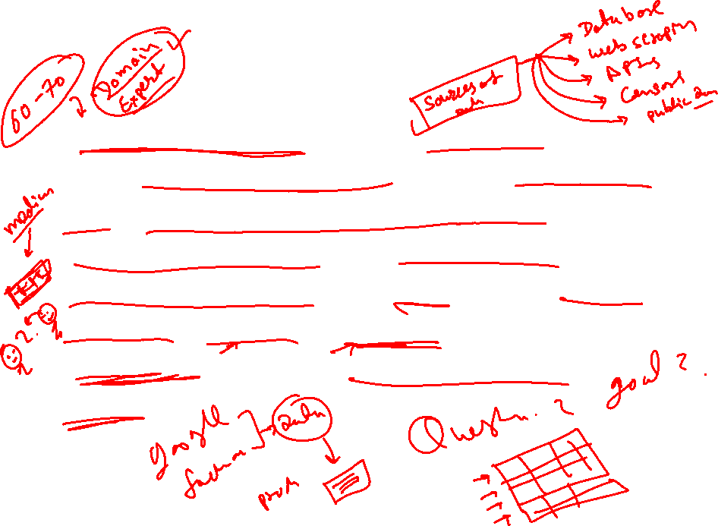
Collection of Data
1. Collection of Data: It is the first step and this is the foundation upon which the entire data set. Careful planning is essential before collecting the data. There are different methods of collection of data such as census, sampling, primary, secondary, etc., and the investigator should make use of correct method.

Slide 5
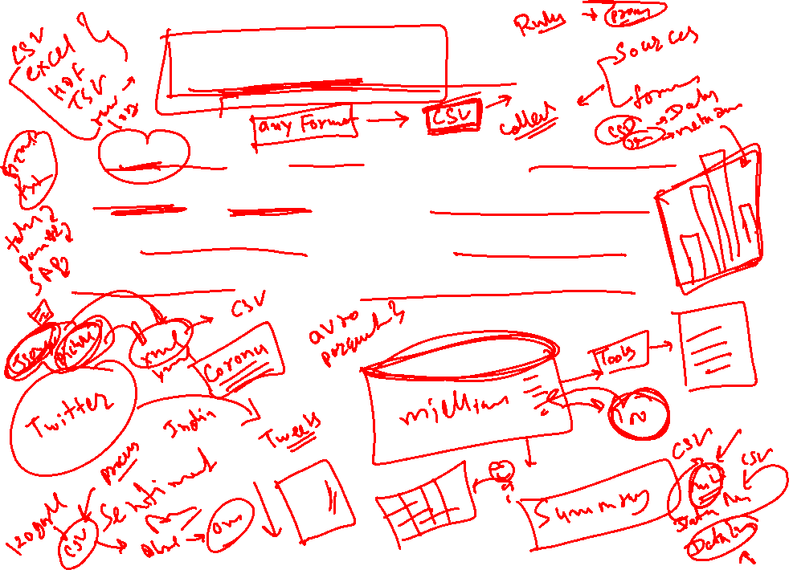
Presentation of data
The mass data collected should be presented in a suitable, concise form for further analysis. The collected data may be presented in the form of tabular or diagrammatic or graphic form.

Slide 6
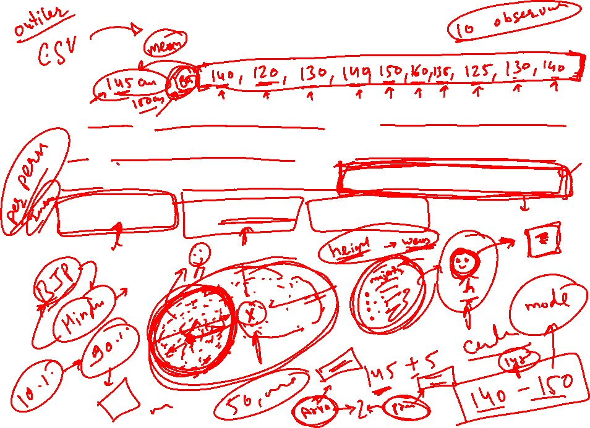
Analysis of data
The data presented should be carefully analysed for making inference from the presented data such as measures of central tendencies, dispersion, correlation, regression etc.,

Slide 7
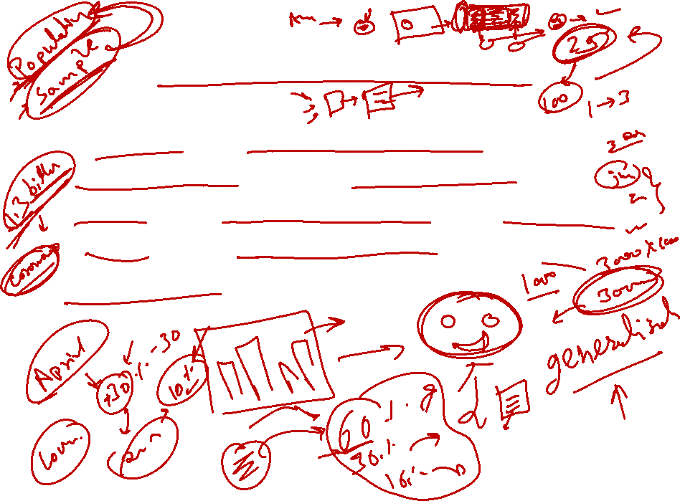
Interpretation of data
The final step is drawing conclusion from the data collected. A valid conclusion must be drawn on the basis of analysis. A high degree of skill and experience is necessary for the interpretation.

Slide 8

List of fields of application of statistics
Actuarial science is the discipline that applies mathematical and statistical methods to assess risk in the insurance and finance industries.
Astrostatistics is the discipline that applies statistical analysis to the understanding of astronomical data.
Biostatistics is a branch of biology that studies biological phenomena and observations by means of statistical analysis, and includes medical statistics.
Business analytics is a rapidly developing business process that applies statistical methods to data sets (often very large) to develop new insights and understanding of business performance & opportunities
Chemo-metrics is the science of relating measurements made on a chemical system or process to the state of the system via application of mathematical or statistical methods.
Demography is the statistical study of all populations. It can be a very general science that can be applied to any kind of dynamic population, that is, one that changes over time or space.
Econometrics is a branch of economics that applies statistical methods to the empirical study of economic theories and relationships.
Environmental statistics is the application of statistical methods to environmental science. Weather, climate, air and water quality are included, as are studies of plant and animal populations.
Epidemiology is the study of factors affecting the health and illness of populations, and serves as the foundation and logic of interventions made in the interest of public health and preventive medicine.
Geostatistics is a branch of geography that deals with the analysis of data from disciplines such as petroleum geology, hydrogeology, hydrology, meteorology, oceanography, geochemistry, geography.
Machine Learning

Slide 9

List of fields of application of statistics
Operations research (or Operational Research) is an interdisciplinary branch of applied mathematics and formal science that uses methods such as mathematical modeling, statistics, and algorithms to arrive at optimal or near optimal solutions to complex problems.
Population ecology is a sub-field of ecology that deals with the dynamics of species populations and how these populations interact with the environment.
Psychometric is the theory and technique of educational and psychological measurement of knowledge, abilities, attitudes, and personality traits.
Quality control reviews the factors involved in manufacturing and production; it can make use of statistical sampling of product items to aid decisions in process control or in accepting deliveries.
Quantitative psychology is the science of statistically explaining and changing mental processes and behaviors in humans.
Reliability Engineering is the study of the ability of a system or component to perform its required functions under stated conditions for a specified period of time
Statistical finance, an area of econophysics, is an empirical attempt to shift finance from its normative roots to a positivist framework using exemplars from statistical physics with an emphasis on emergent or collective properties of financial markets.
Statistical mechanics is the application of probability theory, which includes mathematical tools for dealing with large populations, to the field of mechanics, which is concerned with the motion of particles or objects when subjected to a force.
Statistical physics is one of the fundamental theories of physics, and uses methods of probability theory in solving physical problems.
Statistical Signal Processing
Statistical thermodynamics is the study of the microscopic behaviors of thermodynamic systems using probability theory and provides a molecular level interpretation of thermodynamic quantities such as work, heat, free energy, and entropy.

Slide 10
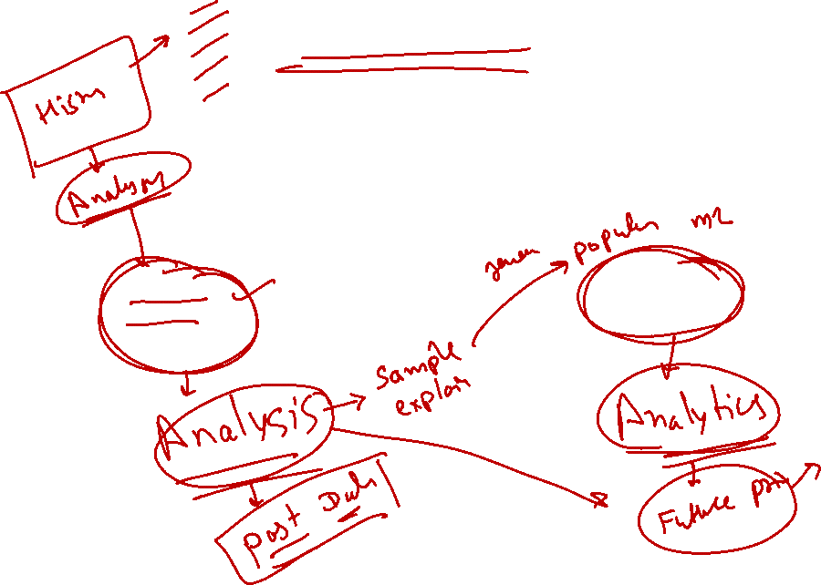
Statistics
Statistics
Descriptive Statistics
Inferential
Statistics

Slide 11
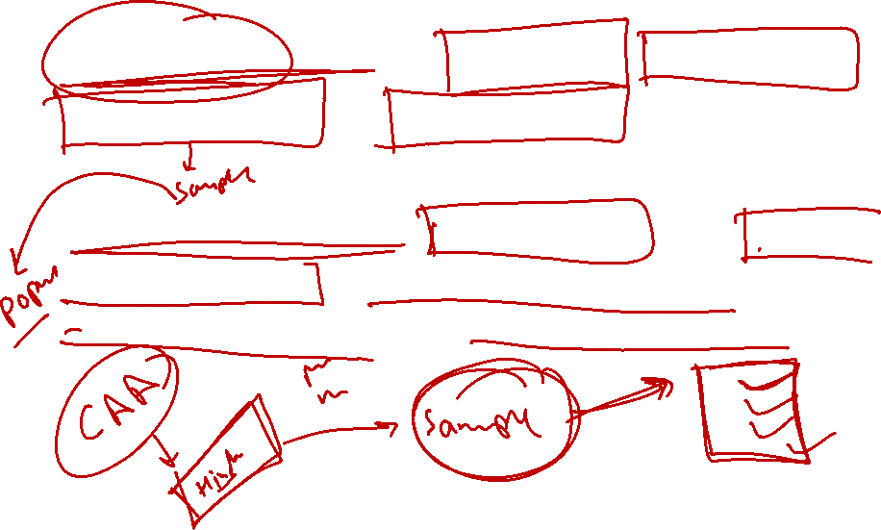
Statistics
Descriptive Statistics: Collection, Organization, summarization and presentation of data.
Inferential Statistics: Generalizing from sample to population, performing estimations and hypothesis testing, and making predictions.

Slide 12
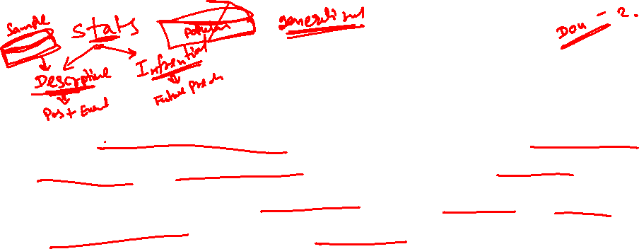
Data Collection
For statistical analysis, whether it is business, economics, social sciences, science, or other fields, the basic problem is to collect facts and figures relating to particular phenomenon under study.

Slide 13
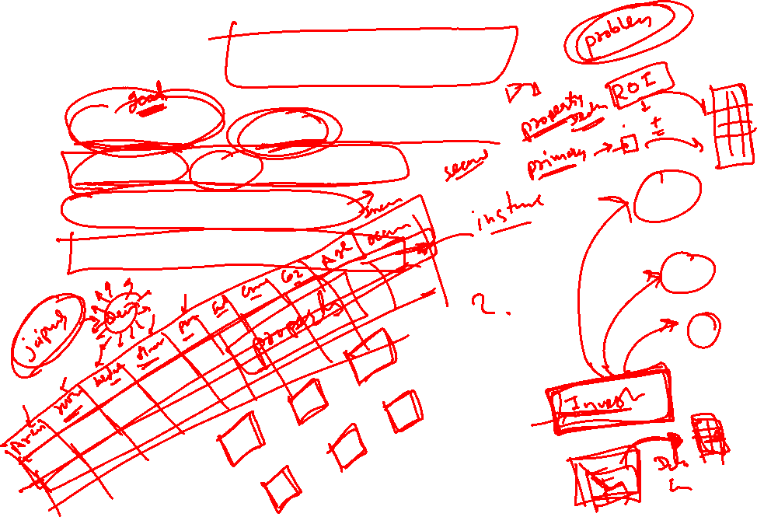
Data Collection
Objectives and scope of the enquiry.
Statistical units to be used.
Sources of information.
Methods of data collection.

Slide 14
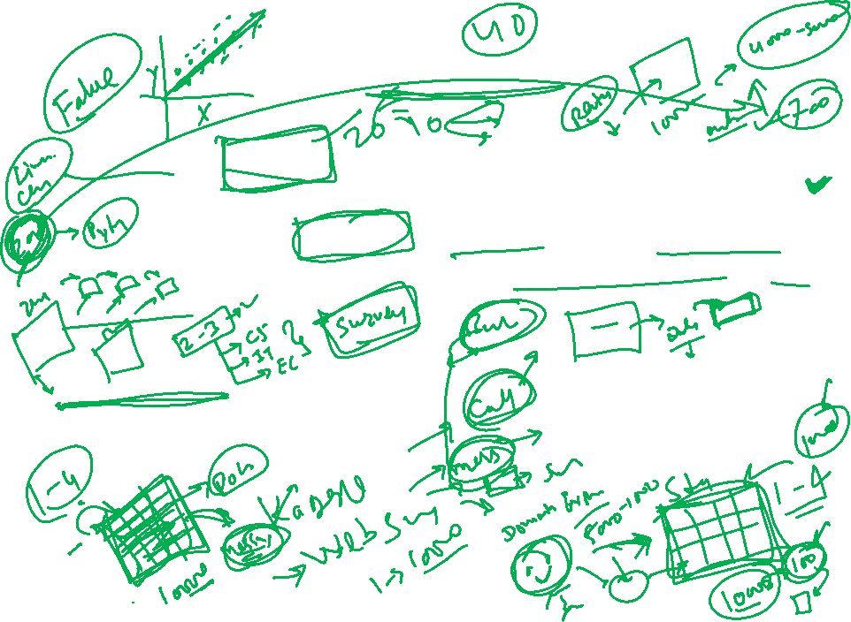
Data Collection
Primary Data: Primary data is the one, which is collected by the investigator himself for the purpose of a specific inquiry or study.
Such data is original in character and is generated by survey conducted by individuals or research institution or any organisation.
Secondary Data: Secondary data are those data which have been already collected and analysed by some earlier agency for its own use; and later the same data are used by a different agency.

Slide 15
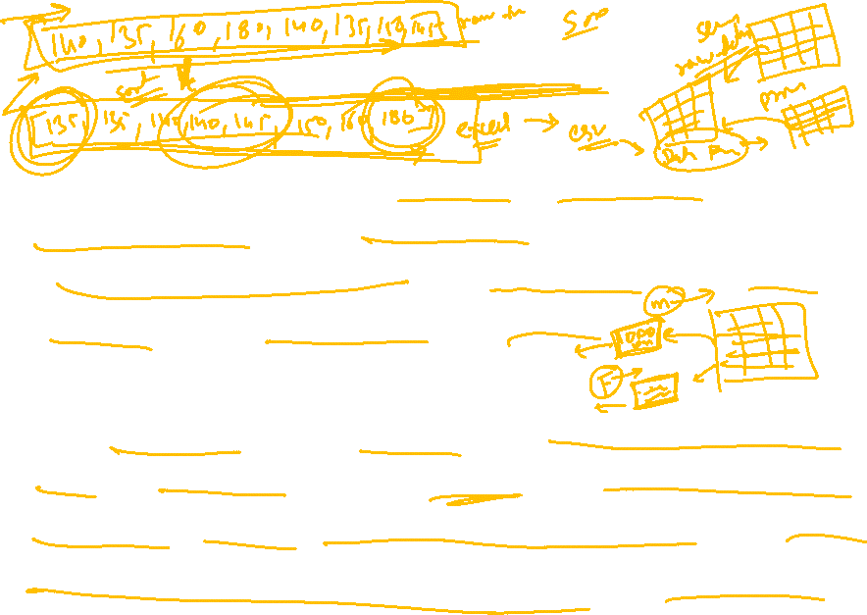
Data Classification
“Classification is the process of arranging the data into sequences and groups according to their common characteristics, or separating them into different but related parts” – Secrist.
“A classification is a scheme for breaking a category into a set of parts, called classes, according to some precisely defined differing characteristics possessed by all the elements of the category” – Tuttle A.M.

Slide 16
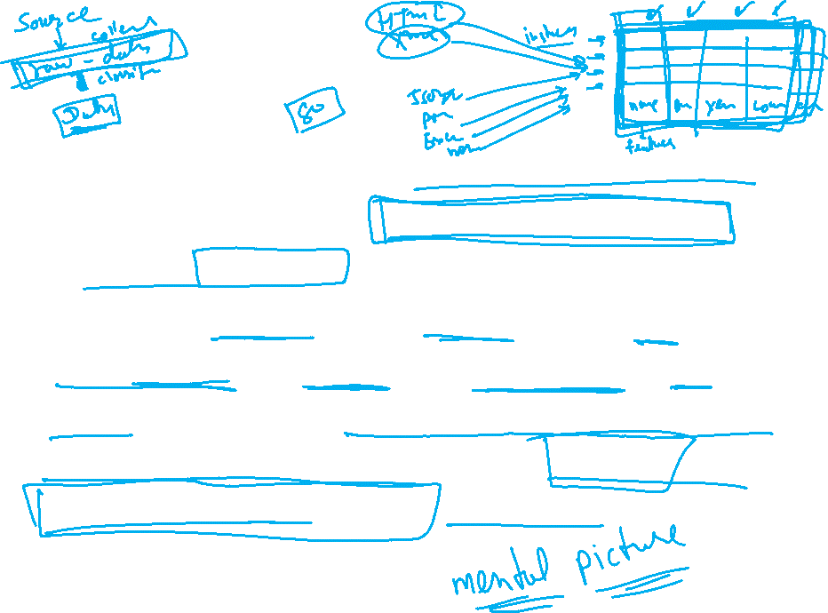
Data Classification
Data is collected for the purpose of analysis.
Data collected in any statistical investigation is known as raw data.
Having collected and edited the data, the next important step is to organise it. i.e. to present in a readily comprehensible condensed form which will highlight the important characteristics of the data.

Slide 17
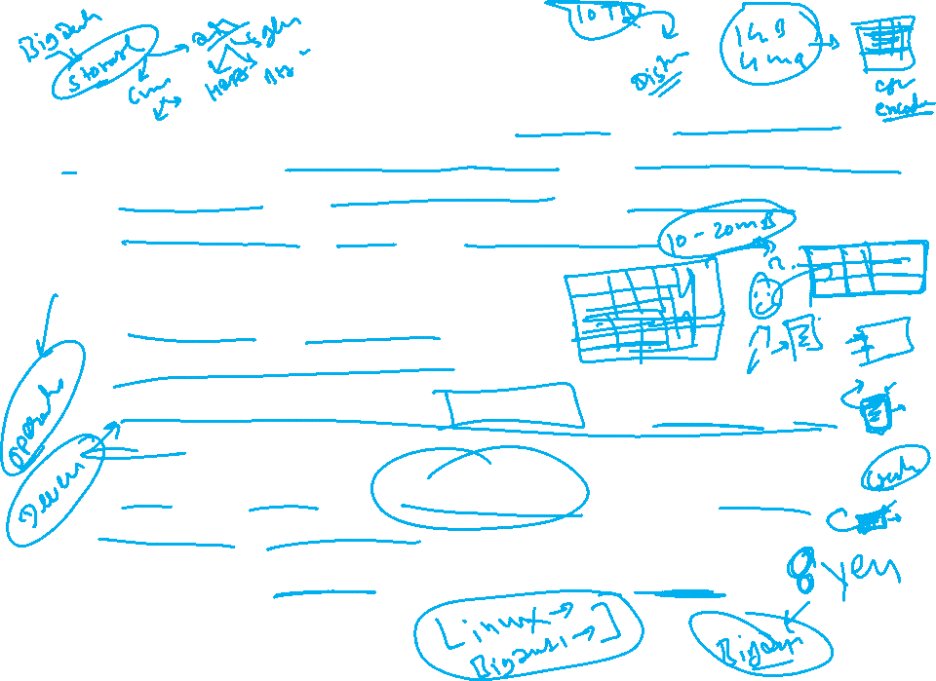
Data Classification
The collected data, also known as raw data or ungrouped data are always in an un organised form and need to be organised and presented in meaningful and readily comprehensible form in order to facilitate further statistical analysis.
Objects of Classification:
It condenses the mass of data.
It eliminates unnecessary details.
It facilitates comparison and highlights the significant aspect of data.
It enables one to get a mental picture of the information and helps in drawing inferences.
It helps in the statistical treatment of the information collected.

Slide 18
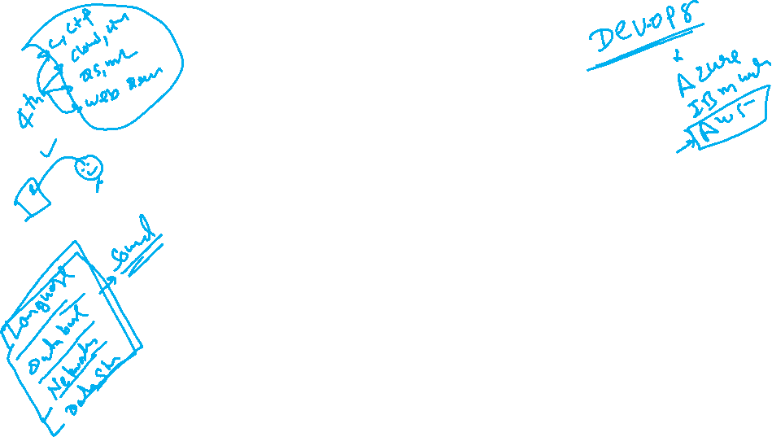
Data Classification
Geographical [Area-wise or regional]
Country | Average Output
India | 123.5
USA | 345.6
Pakistan | 201.45
China | 856.89
Sudan | 123.4
Russia | 345.5
Bangladesh | 456.43

Slide 19
Classification
Chronological Classification:
Population of India (In crores)
Year | Population
1901 | 23.8
1911 | 25.0
1921 | 25.2
1931 | 27.9
1941 | 31.9
1951 | 43.9
1961 | 68.2

Slide 20
Data Classification
Qualitative classification:
Genius
Highly Intelligent
Average Intelligent
Below average
Dull

Slide 21
Data Classification
Quantities Classification:
Daily earnings | Number of stores
1-100 | 23
101-200 | 25
201-300 | 25
301-400 | 27
401-500 | 31
501-600 | 43
601-700 | 68

Slide 22
Data Classification
Why Classification?
It condenses the data.
It facilitates comparison.
It helps to study the relationships.

Slide 23
Data Classification
The statistical data collected are generally raw data or ungrouped data.
Monthly salary (Rs. In ,000) of 30 employees in a Company -
80, 70, 55, 50, 60, 65, 40, 30, 80, 90, 75, 45, 35, 65, 70, 80, 82, 55, 65, 80, 60, 55, 38, 65, 75, 85, 90, 65, 45, 75
The above figures are nothing but raw or ungrouped data.
This representation of data does not furnish any useful information.

Slide 24
Data Classification
Ascending order -
30, 35, 38, 40, 45, 45, 50, 55, 55, 55, 60, 60, 65, 65, 65, 65, 65, 65, 70, 70, 75, 75, 75, 80, 80, 80, 80, 85, 90, 90.
Advantages-
Maximum and minimum values.
It also gives a rough idea of the distribution of the items over the range .

Slide 25
Frequency table
Average salary | No. of Emp.
30-40 | 3
40-50 | 3
50-60 | 5
60-70 | 7
70-80 | 5
80-90 | 7
Total | 30

Slide 26

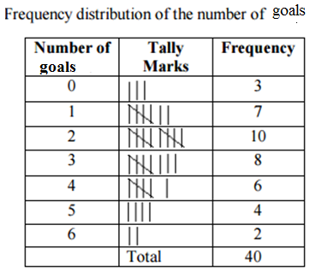
Discrete /Ungrouped frequency distribution
A Survey of 40 football matched was conducted and following data obtained.

Slide 27
Discrete /Ungrouped frequency distribution
Frequency refers to discrete value.
Data are presented in a way that exact measurement of units are clearly indicated.
Each class is distinct and separate from the other class.
Non-continuity from one class to another class exist.

Slide 28
Continuous frequency distribution
Continuous frequency distribution refers to groups of values.
Advantage – Random variable can take any fractional value and the same can be presented in the form of contagious frequency distribution.

Slide 29
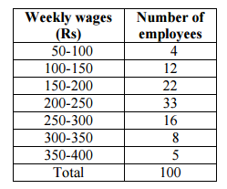
Continuous Frequency Distribution

Slide 30
Definitions
Class limits- The class limits are the lowest and the highest values that can be included in the class. For example, take the class 30-40. The lowest value of the class is 30 and highest class is 40.
Class Interval: The class interval may be defined as the size of each grouping of data. For example, 50-75, 75-100, 100-125… are class intervals.
Width or size of the class interval: The difference between the lower and upper class limits is called Width or size of class interval and is denoted by ‘ C’ .
Range: The difference between largest and smallest value of the observation is called The Range and is denoted by ‘ R’ ie R = Largest value – Smallest value R = L - S

Slide 31
Definitions
Mid-value or mid-point:
The central point of a class interval is called the mid value or mid-point. It is found out by adding the upper and lower limits of a class and dividing the sum by 2.
Mid-Value = (L+ U)/ 2
For example, if the class interval is 20-30 then the mid-value is (20 +30)/ 2 + = 25

Slide 32
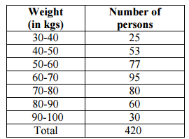
Definitions
Frequency: Number of observations falling within a particular class interval is called frequency of that class.
Frequency

Slide 33
Number of class intervals
The number of class interval in a frequency is matter of importance.
The number of class interval should not be too many.
For an ideal frequency distribution, the number of class intervals can vary from 5 to 15.
To decide the number of class intervals for the frequency distributive in the whole data, we choose the lowest and the highest of the values. The difference between them will enable us to decide the class intervals.

Slide 34
Number of class intervals:
Decision the number of class groupings depends largely on the judgement of the individual investigator and/or the range that will be used to group the data.
Following two rules are often used to decide approximate number of classes in a frequency distribution:

Slide 35
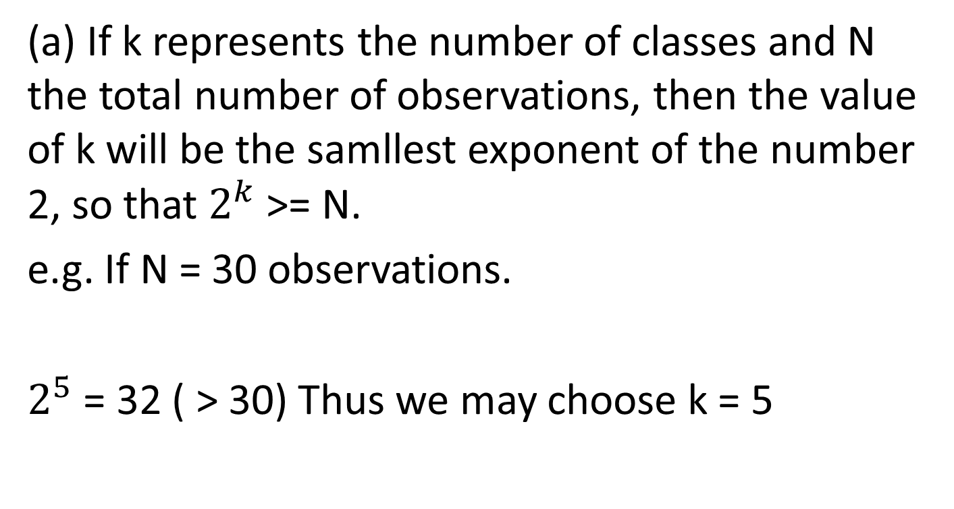
Number of class intervals:
(a) If k represents the number of classes and N the total number of observations, then the value of k will be the samllest exponent of the number 2, so that $2^{k}$>= N.
e.g. If N = 30 observations.
$2^{5}$ = 32 ( > 30) Thus we may choose k = 5

Slide 36
Number of class intervals
(b) Sturges’ Rule K = 1 + 3. 322 log10 N
Where -
N = Total number of observations.
K = Number of class intervals.
Thus if the number of observation is 10, then the number of class intervals is K = 1 + 3. 322 log 10 = 4.322
If 100 observations are being studied, the number of class interval is K = 1 + 3. 322 log 100 = 7.644 @ 8

Slide 37
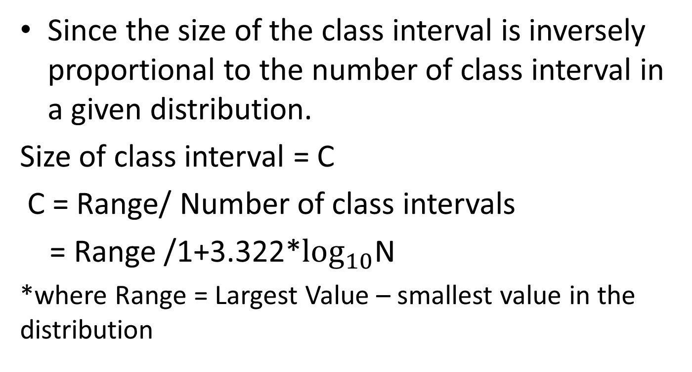
Size of the class interval
Since the size of the class interval is inversely proportional to the number of class interval in a given distribution.
Size of class interval = C
C = Range/ Number of class intervals
= Range /1+3.322*$\log_{10}$N
*where Range = Largest Value – smallest value in the distribution

Slide 38
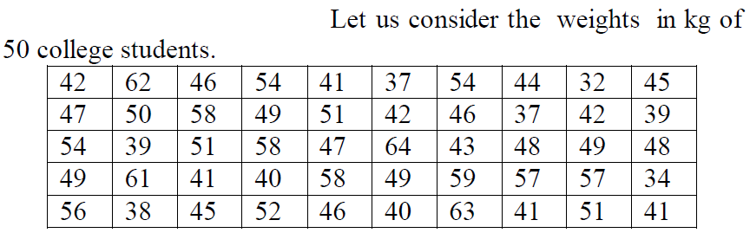
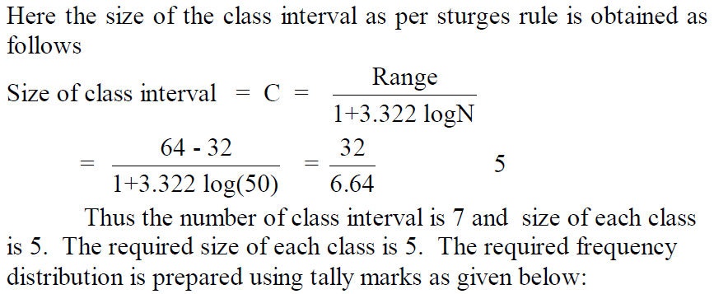

Slide 39
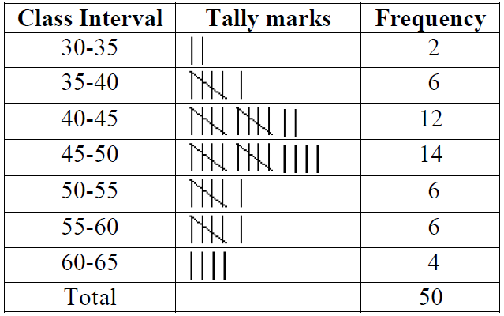

Slide 40
Types of class intervals
Exclusive
Inclusive
Open-end

Slide 41
Exclusive method
When the data are classified in such a way that the upper limit of a class interval is the lower limit of the succeeding class interval (i.e. no data point falls into more than one class interval), then it is said be the exclusive method of classifying data.

Slide 42
Exclusive method
Dividents declared in % | No. of companies
0-10 | 5
10-20 | 6
20-30 | 10
30-40 | 5
40-50 | 3
5 companies declared dividends ranging from 0 to 10 percent.
Company which declared exactly 10 % dividend would not be included in the class 0-10 but would be included in the next class 10-20.

Slide 43
Inclusive Method
When the data are classified in such a way that both lower and upper limits of a class interval are included in the interval itself, then it is said to be the inclusive method of classifying data.
Class intervals | Frequency
0-4 | 5
5-9 | 22
10-14 | 13
15-19 | 8
20-24 | 2

Slide 44
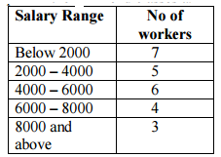
Open end classes

Slide 45

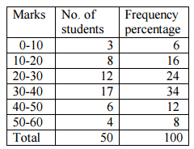
Percentage frequency table

Slide 46
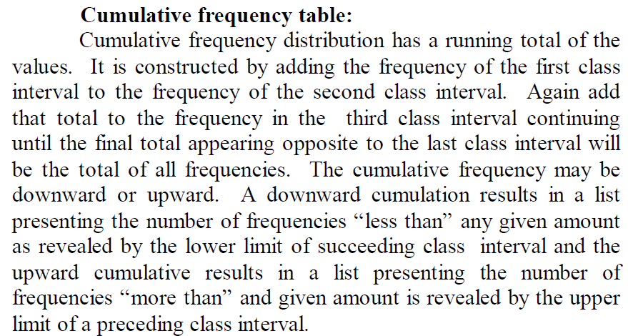

Slide 47
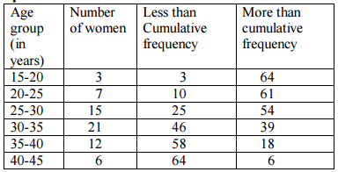
Cumulative frequency table

Slide 48
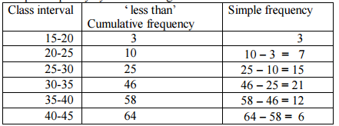
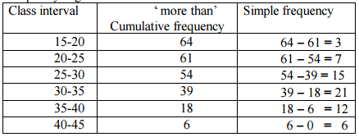
Conversion of cumulative frequency to simple Frequency -

Slide 49
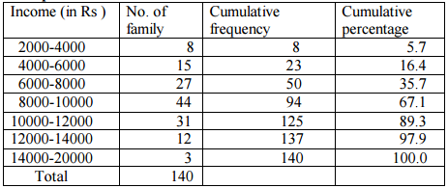
Cumulative percentage Frequency table

Slide 50
Measures of Central Tendency
Frequency distributions and corresponding graphical representations make raw data more meaningful, yet they fail to identify three major properties that describe a set of quantitative data.
The numerical value of an observation (also called as central value) around which most numerical values of other observations in the data set show a tendency to cluster or group, which is called central tendency.
The extent to which numerical values are dispersed around the central value, which is called variation (measure of dispersion)
The extent of the departure of numerical values from symmetrical( normal) distribution around the central value, which is called skewness.

Slide 51
Measures of Central Tendency
“A measure of central tendency is a typical value around which other figures congregate.”
“An average stands for the whole group of which it forms a part yet represents the whole.”

Slide 52
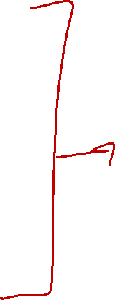
Measures of Central Tendency
Mathematical Averages
Arithmetic Mean
Geometric Mean
Harmonic Mean
Averages of Position
Median
Quartiles
Deciles
Percentiles
Mode

Slide 53

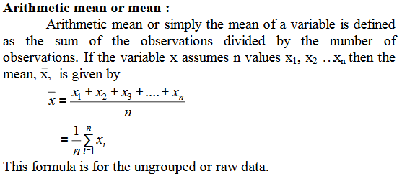
Arithmetic Mean

Slide 54
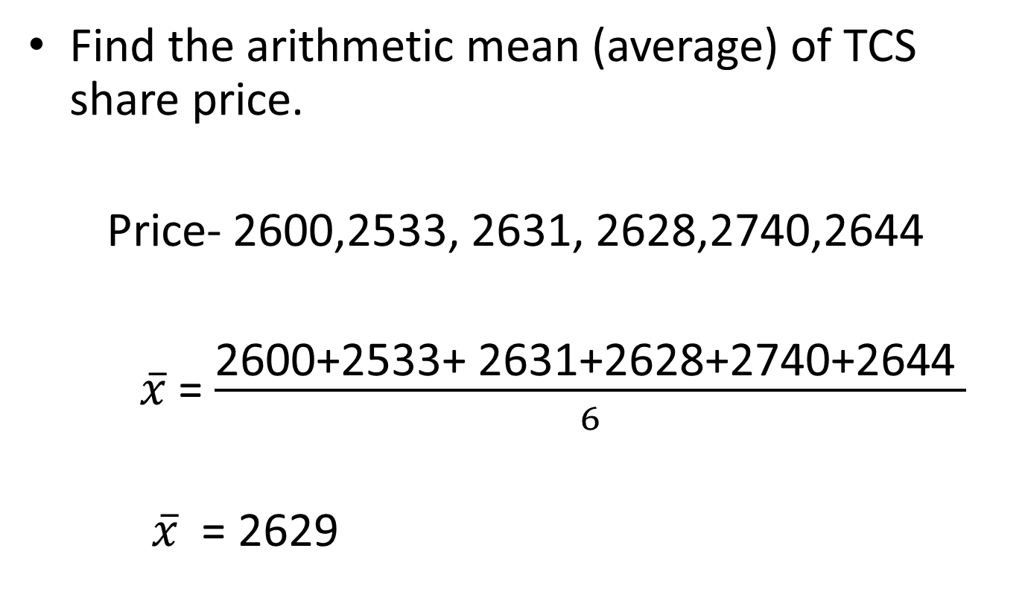
Arithmetic Mean
Find the arithmetic mean (average) of TCS share price.
Price- 2600,2533, 2631, 2628,2740,2644
$\overline{x}$ = $\frac{\text{2600}\text{+}\text{2533}\text{+}\text{ 2631}\text{+}\text{2628}\text{+}\text{2740}\text{+}\text{2644 }}{6}$
$\overline{x}$ = 2629

Slide 55
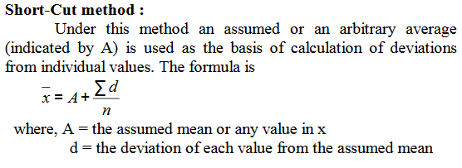
Arithmetic Mean

Slide 56


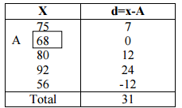
Arithmetic Mean-Step deviation method
Share price of a company for the 5 days is – 75 , 68, 80, 92, 56. Find average share price

Slide 57
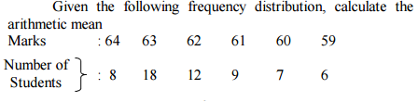
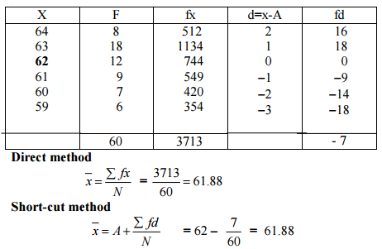
Arithmetic Mean-

Slide 58
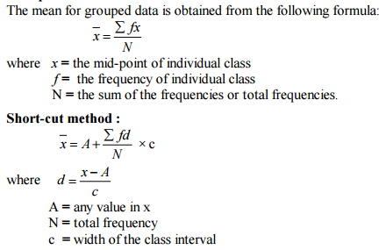
Arithmetic Mean- [Grouped data]

Slide 59
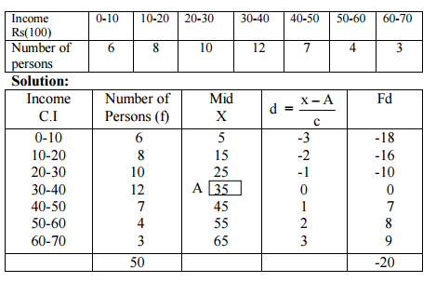

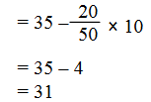
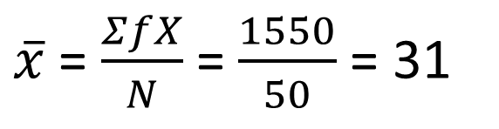
Arithmetic Mean- [Grouped data]
$\overline{x}$ = $\frac{ΣfX}{N}$ = $\frac{1550}{50}$ = 31

Slide 60
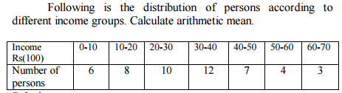
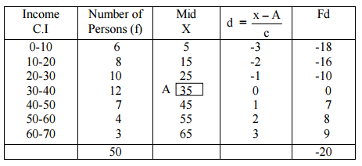
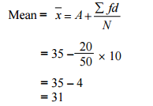

Slide 61
Weighted AM
AM gives equal importance (or weight) to each observation in the data set.
However there are situations in which values of individual observations in the data set are not of equal importance.
If the values occur with different frequencies, then computing AM of values may not be a rue representative of the data set characteristic and thus may be misleading.
Under these circumstances, we may attach to each observation value “weight” w1, w2--- wn as the indicator of their importance and calculate weighted AM.

Slide 62

Weighted Arithmetic mean
The average whose component items are being multiplied by certain values known as “weights” and the aggregate of the multiplied results are being divided by the total sum of their “weight” is called weighted AM.

Slide 63
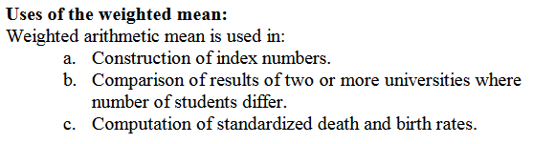
Weighted Arithmetic mean

Slide 64
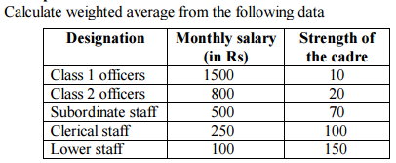
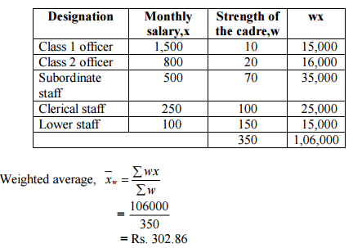
Weighted Arithmetic mean

Slide 65
Weighted Arithmetic mean
A candidate obtained the following % of marks in examination: English 60; Hindi 75; Maths 63, Physics 59, Chemistry 55. Find the candidate weighted AM if weights 1,2,1,3,3 respectively are allocated to subjects
Subject | Marks (%) | Weight(W) | WX
English | 60 | 1 | 60
Hindi | 75 | 2 | 150
Maths | 63 | 1 | 63
Physics | 59 | 3 | 177
Chemistry | 55 | 3 | 165
 |  | 10 | 615
Weighted AM (in%) = 615/10 = 61.5

Slide 66
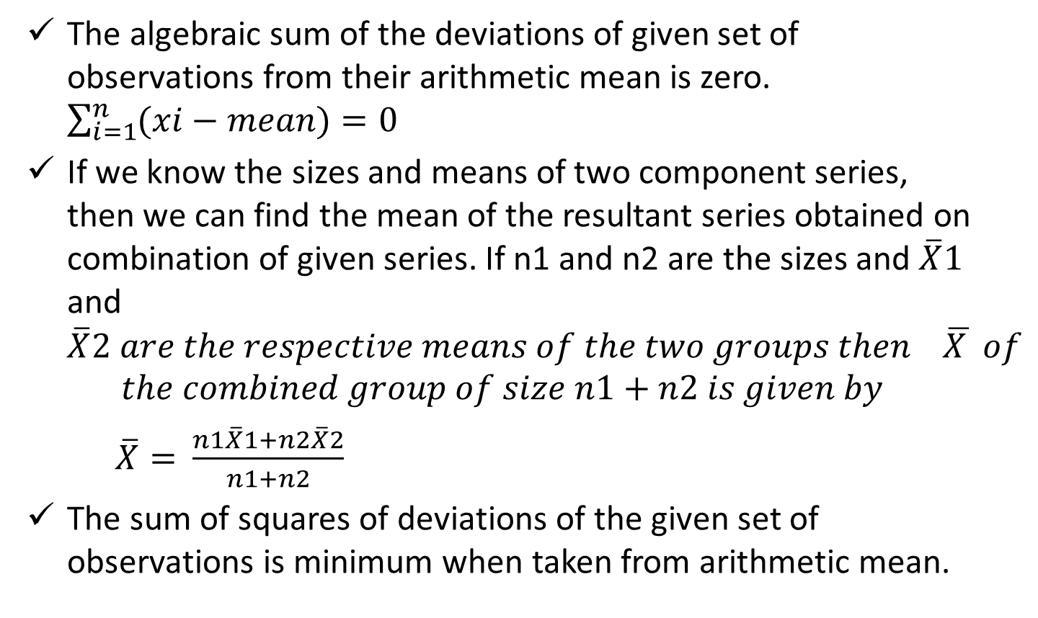
Properties - AM
The algebraic sum of the deviations of given set of observations from their arithmetic mean is zero. $\sum_{i=1}^{n}{(xi−mean)=0}$
If we know the sizes and means of two component series, then we can find the mean of the resultant series obtained on combination of given series. If n1 and n2 are the sizes and $\overline{X}1$ and $\overline{X}2 are the respective means of the two groups then \overline{X } of$
$$the combined group of size n1+n2 is given by$$
$$\overline{X}= \frac{n1\overline{X}1+n2\overline{X}2}{n1+n2}$$
The sum of squares of deviations of the given set of observations is minimum when taken from arithmetic mean.

Slide 67
Arithmetic Mean
Merits –
Arithmetic mean rigidly defined by Algebraic Formula.
It is easy to calculate and simple to understand.
It is based on all observations of the given data.
It is capable of being treated mathematically hence it is widely used in statistical analysis.

Slide 68
Arithmetic Mean
Demerits –
As the data becomes skewed the mean loses its ability to provide the best central location for the data. i.e. It is affected very much by extreme values.
It can neither be determined by inspection or by graphical location
Arithmetic mean cannot be computed for non parametric data.
It cannot be calculated for open-end classes

Slide 69
Arithmetic Mean
Demerits –
Emp.No | 1 | 2 | 3 | 4 | 5 | 6 | 7 | 8 | 9 | 10
Salary | 15k | 18k | 16k | 14k | 15k | 15k | 12k | 17k | 90k | 95k
µ = 30.7

Slide 70
Arithmetic Mean
Trimmed mean: A trimmed mean is computed by trimming away a certain percent of both the largest and smallest set of values.

Slide 71


Geometric Mean
Geometric Mean of set of n observations is the nth root of their products.
If x1, x2 . . . Xn are the observations then

Slide 72

Geometric Mean
Calculate the Geometric average monthly income of 5 families.

Slide 73


Geometric Mean

Slide 74

Geometric Mean

Slide 75

Geometric Mean

Slide 76


Geometric Mean
Investment return for Rs. 10,000 is as below.
Find the average rate of return.
GM = $\sqrt[5]{\begin{aligned}1.05∗1.2∗1.25.0.9∗1.2 \\ \end{aligned}}$
GM = 11.20

Slide 77
Geometric Mean
1st year = 100% return
2nd year = -50% return
Is your average return 25% or 0%

Slide 78
Geometric Mean
Suppose your stock portfolio earned a 10% return in year 1 and a 20% return in year 2. What happened? If you invested $100, then at the end of year 1 it grows to $100 x (1 + 10%) = $100 x (1.10) = $110. So, we start year 2 with $110, and that year goes very well, and we earn 20%, so our balance grows to $110 x 1.20 = $132. What is the geometric average return? It turns out that it's 14.89% Now, let's look at what would have happened if we had earned that geometric average return every year: We start out investing $100, and we get a return of 14.89% in the first year, so we end the first year with a balance of $100 x 1.1489 = $114.89. Then, we start year 2 with $114.89, and again we get a return of 14.89%, so we end year 2 with a balance of $114.89 x 1.1489 = $132.

Slide 79
Geometric distribution
Find the average rate of increase in population which in the first decade had increased by 20%, in the next by 30% and in the third by 40%

Slide 80
Geometric Mean
The geometric mean is used when dealing with average investment returns, Growth Rates, Portfolio return, etc.

Slide 81
Geometric Mean
Merits:
It is rigidly defined.
2. It is based on all items.
3. It is very suitable for averaging ratios, rates and percentages.
4. It is capable of further mathematical treatment.
5. Unlike AM, it is not affected much by the presence of extreme values.

Slide 82
Geometric Mean
Demerits:
It cannot be used when the values are negative or if any of the observations is zero
It is difficult to calculate particularly when the items are very large or when there is a frequency distribution.

Slide 83

Weighted GM
GM(W) = Antilog(∑WlogX/ ∑W)

Slide 84

Harmonic Mean

Slide 85

Harmonic Mean

Slide 86



Harmonic Mean

Slide 87
Harmonic Mean
A cyclist pedals from his house to his college at a speed of 10 k.m.p.h. and back from the college to his house at 15 k.m.p.h. Find the average speed.
Solution: Speed = Distance/ Time.
Let x be the distance from house to college.
Average speed = Total distance/Total time.
Average speed = 2x/[x/10 + x/15] = 12 kmph.

Slide 88
Harmonic Mean
An investor buys Rs. 1,200 worth of shares in a company each month. During the first 5 months, he bought the shares at a price of Rs. 10, Rs. 12, Rs.15, Rs, 20 and Rs. 24 per share. After 5 months what is the average price paid for the shares by him?
Solution: Since the share value is chngine after a fixed unit of time ( 1 month), The required average price per share is harmonic mean of 10,12,15,20,24.
5/ [ 1/10 + 1/12 + 1/ 15 + 1/20 = 1/24] = 14.63.

Slide 89
Month | Price per share [x] | Total cost [ fx] | Number of shares boutht [ f]
1 | 10 | 1200 | 120
2 | 12 | 1200 | 100
3 | 15 | 1200 | 80
4 | 20 | 1200 | 60
5 | 24 | 1200 | 50
 |  | Σ fx = 6000 | Σ f= 410
Average price = Σ fx / Σ f
= 6000 / 410
= 14.63

Slide 90


Harmonic Mean
Weighted HM: Instead of fixed (constant) distance being travelled with varying speeds, let us now suppose that different distances are travelled with corresponding different speeds. What is the average speed.
Speed = $\frac{Distance(S)}{Time(t)}$
t1 = $\frac{s1}{v1 }$ t2 = $\frac{s2}{v2}$ …….. tn= $\frac{sn}{vn}$
Average speed = $\frac{ \text{Σ}s}{ \text{Σ}(\frac{s}{v})}$

Slide 91

Harmonic Mean
If you make a trip which entails travelling 900 kms by train at an average speed of 60 kmph; 3000 kms by boad at an average speed of 25 kmph; 400 kms by plane at 350 kmph, and finally 15 ksm by taxi at 25 kmph. What is your average speed for the entire distance.
X (speed) | W(Distance) | W/X
60 | 900 | 15
25 | 3000 | 120
350 | 400 | 1.43
25 | 15 | 0.60
Total | 4315 | 137.03
Average speed = $\frac{ \text{Σ}W}{ \text{Σ}(\frac{W}{X})}$
= 4315/ 134.03
= 31.49 km. ph.

Slide 92
Harmonic Mean
Merits:
It is rigidly defined.
It is defined on all observations.
It is the most suitable average when it is desired to give greater weight to smaller observations and less weight to the larger ones.
It gives greater importance to small items and is therefore, useful only when small items have to be given greater weightage.

Slide 93

Harmonic Mean
If the population (or sample) has a few data points that are much higher than the rest (outliers), the harmonic mean is the appropriate average to use. Unlike the arithmetic mean, the harmonic mean gives less significance to high-value outliers–providing a truer picture of the average.

Slide 94
Median
“The median is that value of the variable which divides the group into two equal parts, one part comprising all the values greater and the other, all the values less than median” – L.R. Conner
Thus median of distribution may be defined as that value f the variable which exceeds and is exceeded by the same number of observations.

Slide 95

Median
Ungrouped Data :
Arrange the given values in the increasing or decreasing order.
If the number of values are odd, median is the middle value.
If the number of values are even, median is the mean of middle two values. By formula Median = Md = $\frac{(n+1)}{2}$thitem.

Slide 96

Median
Ungrouped Data :

Slide 97


Median

Slide 98



Median

Slide 99
Median
Grouped Data:
In a grouped distribution, values are associated with frequencies. Grouping can be in the form of a discrete frequency distribution or a continuous frequency distribution.
Whatever may be the type of distribution , cumulative frequencies have to be calculated to know the total number of items.
Cumulative frequency: (C.F.) Cumulative frequency of each class is the sum of the frequency of the class and the frequencies of the pervious classes, ie adding the frequencies successively, so that the last cumulative frequency gives the total number of items.

Slide 100

Median

Slide 101




Median

Slide 102

Median

Slide 103

Median

Slide 104



Median

Slide 105
Median
Merits:
It is rigidly defined.
Since median is a positional average, it is not affected at all by extreme values. So it is very useful in the case of skewed distributions.
Median can be computed while dealing with a distribution with open end classes.

Slide 106
Median
In case of even number of items or continuous series, median is an estimated value other than any value in the series.
It is not suitable for further mathematical treatment except its use in mean deviation.
It is not taken into account all the observations.

Slide 107
Partition Values
The values which divide the series into a number of equal parts are called the partition values.
Median may be regarded as a particular partition value which divides the given data into two equal parts.

Slide 108
Partition Values
Quartiles: The values which divide the given data into four equal parts are known as quartiles.
There will be three such points Q1, Q2, Q3, such that Q1 < Q2<Q3.
Q1, known as the lower or first quartile is the value which has 25% of the items of the distribution below it and consequently 75% of the items are greater than it.
Q2, the second quartile, coincides with the median and has an equal number of observations above and below it.
Q3, known as the upper or third quartile, has 75% of the observations below it and consequently 25% of the observations above it.

Slide 109

Quartile Deviation
In a symmetric distribution, the two quartiles Q1, and Q3 are equidistant from median. Thus Median(±) quartile deviation coveres 50 % of the observations.
Coefficient of quartile deviation = (Q3 – Q1)/ (Q3 + Q1)

Slide 110
Quartile Deviation
The wheat production (in Kg) of 20 acres is given as: 1120, 1240, 1320, 1040, 1080, 1200, 1440, 1360, 1680, 1730, 1785, 1342, 1960, 1880, 1755, 1720, 1600, 1470, 1750, and 1885. Find the quartile deviation and coefficient of quartile deviation.

Slide 111

Quartile Deviation

Slide 112



Quartile Deviation

Slide 113


Quartile Deviation

Slide 114



Slide 115

Deciles
Deciles are the values which divide the series into ten equal parts.
There are 9 deciles. D1, D2 … D9.
D5 coincides with the median.
The method of computing the deciles Di( I = 1,2 ….9) is same as discussed for Q1 and Q2. To compute the ith decile, see c.f. just greater than $\frac{i∗n}{10}$ . The corresponding value of X is Di.

Slide 116




Slide 117
Percentiles
The percentile values divide the distribution into 100 parts each containing 1 percent of the cases. The percentile (Pk) is that value of the variable up to which lie exactly k% of the total number of observations.
P25 = Q1 ;
P50 = D5 = Q2 = Median
P75 = Q3

Slide 118

Percentiles

Slide 119


Percentiles

Slide 120
Mode
Mode is the value which occurs most frequently in a set of observations and around which the other items of the set cluster densely.
Mode is the value of a series which is predominant in it.

Slide 121
Mode
The average size of the shoe sold in a shop is 7.
Average height of an Indian male is 1.66 meters,
Average size of the shirt sold in a ready-made garment shop is 35 cm.
The average referred to is neither mean nor median but mode. The most frequent value in the distribution.

Slide 122


Mode

Slide 123





Slide 124



Slide 125
Mode
Merits of Mode:
It is easy to calculate and in some cases it can be located mere inspection
Mode is not affected by extreme values.
It can be calculated for open-end classes.
It is usually an actual value of an important part of the series.
In some circumstances it is the best representative of data.

Slide 126
Mode
Demerits of Mode:
It is not based on all observations.
It is not capable of further mathematical treatment.
Mode is ill-defined generally, it is not possible to find mode in some cases.
As compared with mean, mode is affected to a great extent, by sampling fluctuations.
It is unsuitable in cases where relative importance of items has to be considered.

Slide 127

Relationship Between AM, GM, HM
AM ≥ GM ≥ HM
For two numbers. $G^{2}$ = A X H

Slide 128
Selection of Average
Nature and availability of data and purpose plays important role in selecting the average
AM is not recommended while dealing with frequency distribution with extreme observations or open end classes.
Median and mode are averages to be used while dealing with open end classes.
Mode is particularly used in business decisions.
Harmonic mean is to be used in computing special types of average rates or ratios where time factor is variable and the act being performed like distance is constant.
GM is used for calculating returns, diminishing value, etc.

